Slide 1
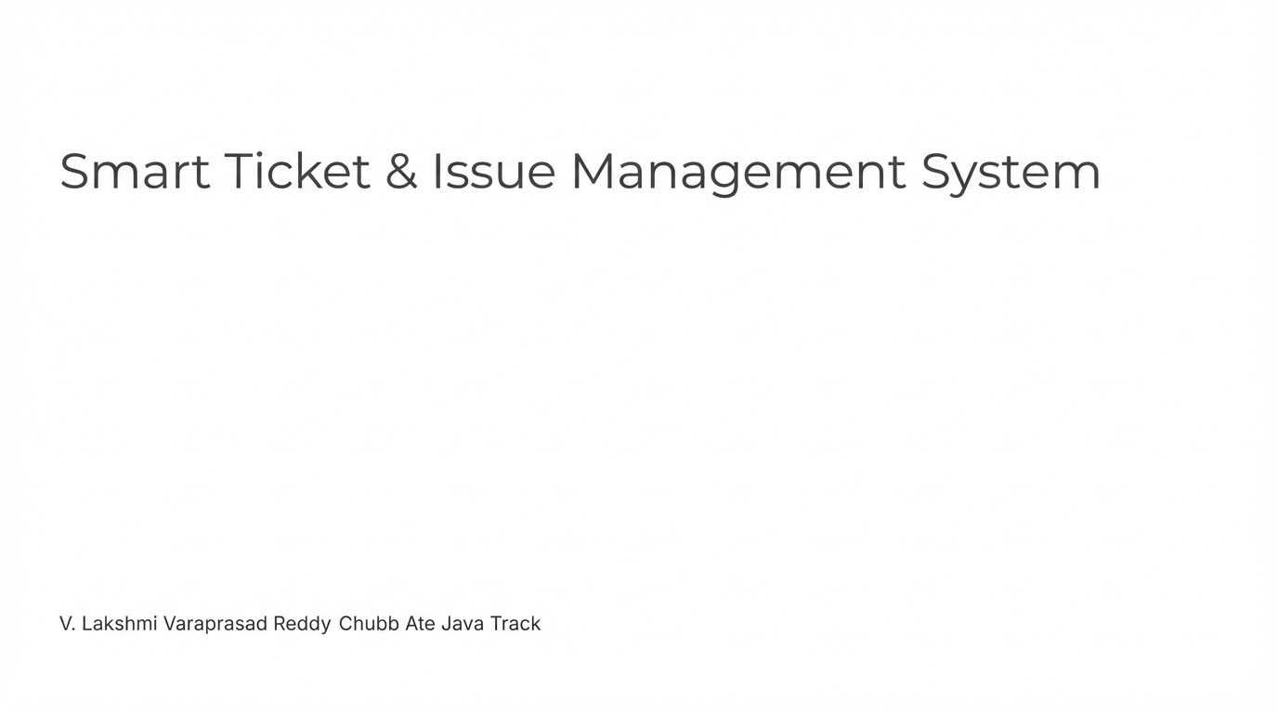

Slide 2
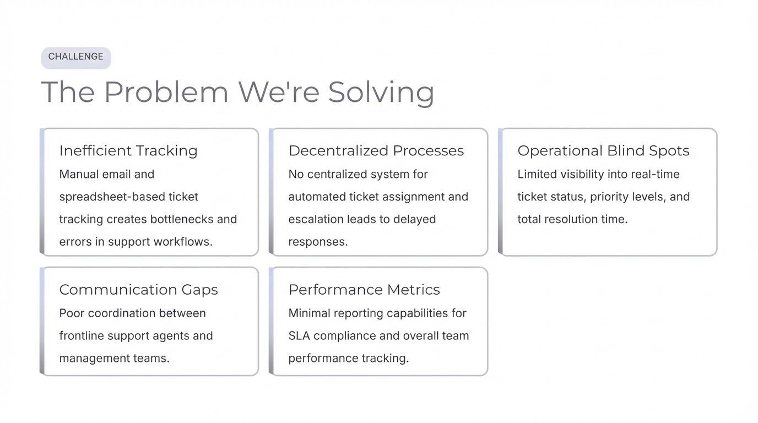

Slide 3
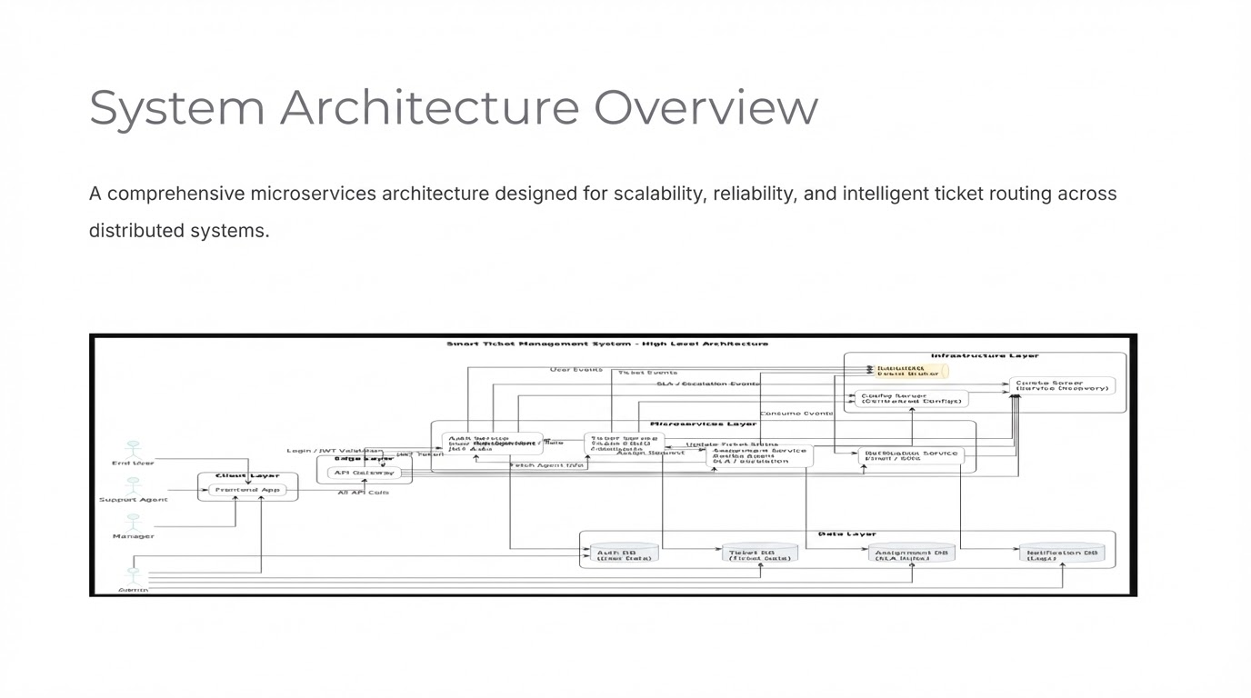

Slide 4













ARCHITECTURE
7 Independent Microservices
Auth Service
Ticket Service
Authentication & Authorization
Core ticket management
Assignment Service
Notification Service
Smart ticket routing
Real-time alerts
API Gateway
Eureka Server
Request routing
Service discovery
Config Server
Github Properties

Slide 5
Key Technologies
Spring Boot & Spring Cloud for microservices framework
MySQL & MongoDB for hybrid data storage
RabbitMQ as message broker for async communication
Docker & Docker Compose for containerization
JWT Authentication for secure access control

Slide 6



DATA LAYER
Database Design Strategy
My sql
MongoDB
Relational Data
Document Data
Users Table
Tickets Collection
Assignments Table
Comments Collection
Notifications Table
Attachments
Hybrid database approach combines relational integrity with flexible document storage for complex ticket structures.

Slide 7

My Sql Schema
1
Users Table
Authentication credentials and comprehensive user profiles for all system participants.
2
Assignments Table
Complete ticket assignment history tracking for accountability and audit trails.
3
Notifications Table
Event notifications and alert management for real-time communication.
4

Slide 8



MongoDB Collections
Tickets Collection
Comments Collection
Flexible schema design accommodates complex ticket structures with extensible properties and dynamic fields.
Embedded comments within ticket documents enable threaded conversations and collaboration history.
Attachments
File URLs and metadata storage for supporting documentation and evidence.

